Slide 1
Project Schedule Formatting—Fundamentals
Microsoft Project 2016
Lesson 8

Slide 2
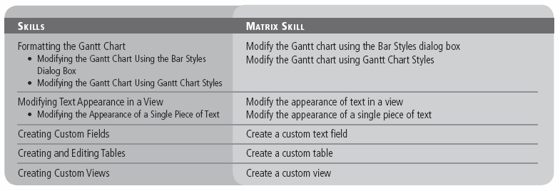
Objectives

Slide 3
Software Orientation
In Microsoft Project, you can use the Bar Styles dialog box (see the figure on the next slide) to customize the appearance of items on the Gantt chart.
This dialog box enables you to change the appearance of items such as task bars, milestones, summary bars, and text that appear on the Gantt chart.
You can change characteristics such as bar types, patterns, colors, splits, and shapes.

Slide 4
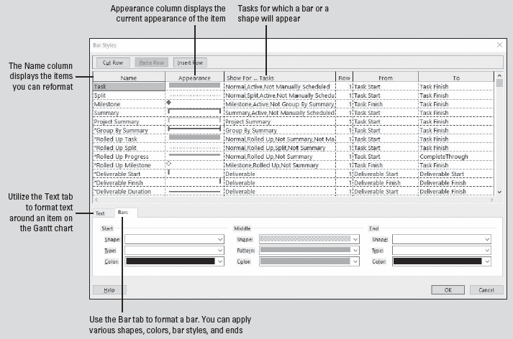
Software Orientation
Notes:
Bar Styles dialog box

Slide 5

Software Orientation
You will now use one of the features of the ribbon interface in Project 2016, the Format ribbon. With the ribbon, you have faster access to formatting options in views.
You might have seen in the various views of previous lessons a tab at the very top of the screen, above the ribbon. This is the Format tab and it provides formatting options available in the view you are in at the time. The figure below shows the Format ribbon for the Gantt Chart view.
Notes:
Format ribbon for Gantt Chart views

Slide 6
Formatting the Gantt Chart
The Gantt Chart view consists of two parts: a table on the left and the bar chart on the right.
The default formatting of the Gantt Chart view is useful for on‐screen project schedule viewing and printing. However, you are able to change the formatting of almost any element on the Gantt chart to suit your needs.
In the next exercise, you learn to format Gantt chart task bars.
You can format whole categories of Gantt chart task bars via the Bar Styles dialog box, or you can format individual Gantt chart task bars directly.

Slide 7
Modifying the Gantt Chart Using the Bar Styles Dialog Box
In Microsoft Project, the Gantt Chart view is the default view. A view is a window through which you can see various elements of your project schedule. In the following exercise, you will use the Bar Styles dialog box to make formatting changes to several items in the Gantt Chart view.
The Gantt chart is the primary way of viewing the data in a project schedule. It became the standard for visualizing project schedules in the early twentieth century when American engineer and management consultant Henry L. Gantt developed a bar chart with two main principles:
To measure activities by the amount of time needed to complete them.
To use the space on the chart to represent the amount of the activity that should have been done in that time.

Slide 8
Step-by-Step: Modify the Gantt Chart Using the Bar Styles Dialog Box
GET READY. Before you begin these steps, open Tailspin Remote Drone 8M from the data files for this lesson. SAVE the file as Tailspin Remote Drone 8 in the solutions folder.
Click the Format tab; then, in the Bar Styles group, click the Format button. Select Bar Styles from the drop‐down list. The Bar Styles dialog box appears.
In the Name column, select Milestone. You want to change the shape of the milestones on the Gantt chart.
In the bottom half of the dialog box under the Start label, locate the Shape box. Select the star shape from the drop‐down list in the Shape box. Note that the star shape now appears in the Appearance column for Milestone. Your screen should look similar to the figure on the next slide.

Slide 9
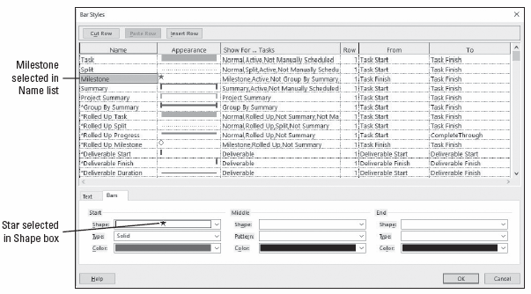
Step-by-Step: Modify the Gantt Chart Using the Bar Styles Dialog Box
Notes:
Bar Styles dialog box displaying the star as the shape for milestones

Slide 10
Step-by-Step: Modify the Gantt Chart Using the Bar Styles Dialog Box
In the Name column at the top of the dialog box, select Task.
In the bottom half of the dialog box, click the Text tab. You want to make a change to display the resource groups assigned rather than full names next to the task bars.
On the Text tab, in the Right box, select Resource Names, click the down arrow (located at the far right), and then select Resource Group.
Your screen should look similar to the figure on the next slide.

Slide 11
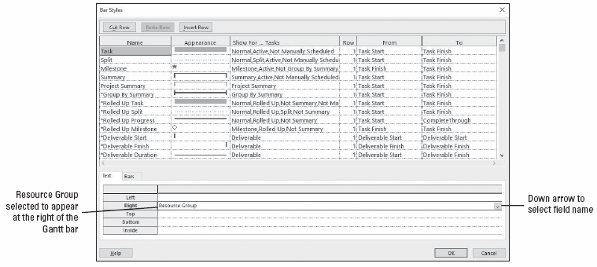
Step-by-Step: Modify the Gantt Chart Using the Bar Styles Dialog Box
Notes:
Bar Styles dialog box showing Resource Group to be listed at the right of all task Gantt chart bars

Slide 12
Step-by-Step: Modify the Gantt Chart Using the Bar Styles Dialog Box
Click OK to close the Bar Styles dialog box. Microsoft Project applies the formatting changes you made to the Gantt chart. Your screen should look similar to the figure on the next slide.
SAVE the project schedule.
PAUSE. LEAVE the project schedule open to use in the next exercise.
Notes:
Take Note: With the Bar Styles dialog box, the formatting changes you make to a type of item (a milestone, for example) apply to all such items in the Gantt chart.

Slide 13
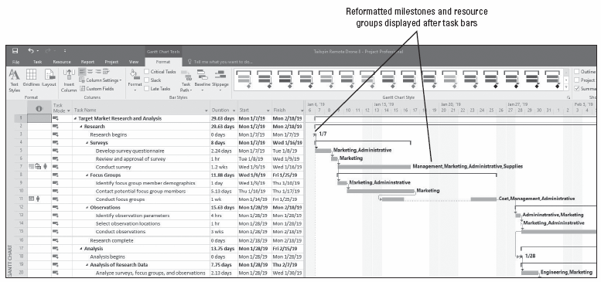
Step-by-Step: Modify the Gantt Chart Using the Bar Styles Dialog Box
Notes:
Gantt Chart view showing resource initials and the new shapes for milestones

Slide 14
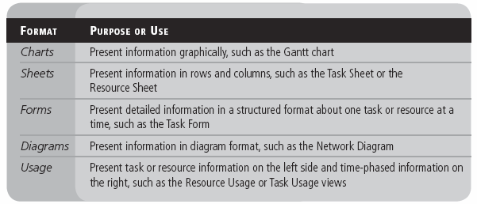
Modifying the Gantt Chart Using the Bar Styles Dialog Box
The two main view categories are named single view, which you have been using mostly throughout the lessons, and one you will see later in this lesson called a combination view.
Views are made up of one or more view elements. The five different view formats and their common uses are listed in the table below.

Slide 15
Modifying the Gantt Chart Using Gantt Chart Styles
In the following exercise, you will create a custom Gantt chart, format it using predefined Gantt Chart Styles, and then save the custom view.
In this exercise, you will make formatting changes to your project schedule using predefined Gantt Chart Styles. This is similar to making changes using the Bar Styles command; however, the predefined Gantt Chart Styles have fewer choices than the Bar Styles command.
As you are reviewing the formatting changes in the My Custom Gantt Chart view, remember that none of the data in the project schedule has changed—just the way it is formatted. These formatting changes affect only the My Custom Gantt Chart view; all other views in Microsoft Project are unaffected.

Slide 16
Step-by-Step: Modify the Gantt Chart Using Gantt Chart Styles
GET READY. USE the project schedule you created in the previous exercise.
Click the Format tab, under Gantt Chart Tools, if necessary.
In the Show/Hide group, ensure that the Project Summary Task check box is checked.
Press F5. In the ID box, key 0 and click OK. Microsoft Project displays the project summary task (task ID 0) at the top of the Gantt Chart view. You will make a few adjustments to your screen so that all of the summary task information is visible.
Double‐click the right edge of the Task Name column, in the column heading, to expand the column so that you can see the entire value.
Notes:
Another Way: You can also double‐click the divider bar to snap the divider to the nearest column edge.

Slide 17
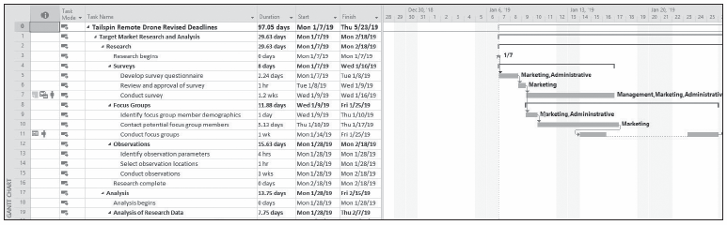
Step-by-Step: Modify the Gantt Chart Using Gantt Chart Styles
Drag the vertical divider bar between the table and chart to the right until at least the Duration, Start, and Finish columns are visible. Adjust the vertical divider bar, as necessary. Your screen should look similar to the figure below.
Before you make further formatting changes, you will make a copy of the Gantt Chart view so that you will not affect the original.
Notes:
Gantt chart showing widened Task Name column and project summary task
Another way: Right‐clicking anywhere in a column heading activates the submenu for the column. Selecting Field Settings displays the Field Settings dialog box. In the dialog box, click the Best Fit button to automatically adjust the column width.

Slide 18

Step-by-Step: Modify the Gantt Chart Using Gantt Chart Styles
Click the View tab. In the Task Views group, click the down arrow under the Gantt Chart button and then select Save View. The Save View dialog box appears with View 1 as the default name, as shown in the figure below.
In the Name field, key My Custom Gantt Chart and then click OK. The Save View dialog box closes. Note that the name of the new view is listed on the left edge of your screen. Your screen should look similar to the figure on the next slide.
Notes:
Save View dialog box

Slide 19
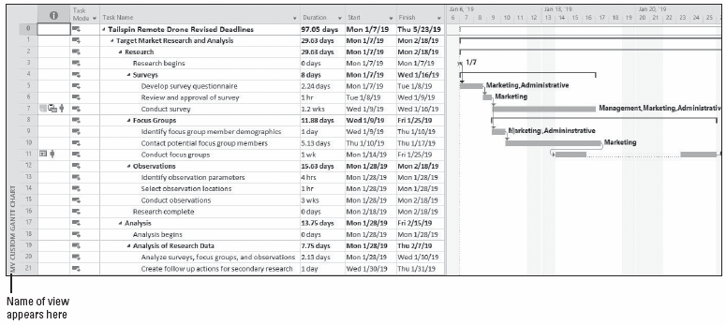
Step-by-Step: Modify the Gantt Chart Using Gantt Chart Styles
Click the Format tab. In the Gantt Chart Styles group, click the More button located at the lower right of the bar graphics; see the top figure on the next slide.
Notes:
My Custom Gantt Chart view

Slide 20
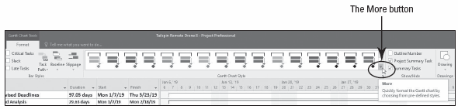
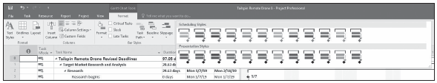
Step-by-Step: Modify the Gantt Chart Using Gantt Chart Styles
The predefined Gantt Chart Style options appear as shown in the figure below. These are divided into two style categories, one for scheduling and one for presentations. Select the fourth style from the left in the scheduling category.
Notes:
The More button (top figure) displays predefined Gantt bar styles (bottom figure)

Slide 21
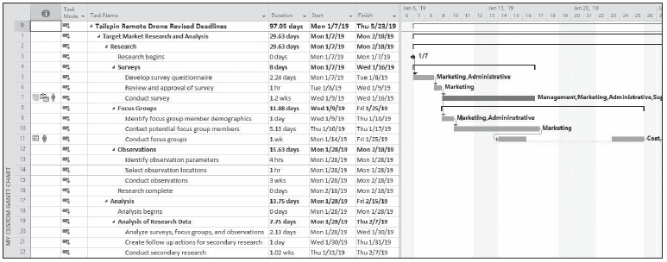
Step-by-Step: Modify the Gantt Chart Using Gantt Chart Styles
On the Format ribbon, in the Bar Styles group, click the Critical Tasks check box. Your screen should look like the figure below.
SAVE the project schedule.
PAUSE. LEAVE the project schedule open to use in the next exercise.
Notes:
My Custom Gantt Chart view with new scheduling style applied and critical tasks
Take Note: Notice that the resource groups still are displayed to the right of the Gantt bars, but the milestones have been changed back to the default diamond shape.

Slide 22
Modifying Text Appearance in a View
Microsoft Project enables you to change the way text appears within a view.
You can modify the appearance of an entire category of tasks, such as summary tasks or milestones, or you can change the appearance of an individual cell.
This feature allows you to call attention to specific items or to offset a specific type of task with color and font size or type.
In this exercise, you will modify the way all text appears for summary tasks. In the next exercise, you will modify a single piece of text.

Slide 23
Step-by-Step: Modify the Appearance of Text in a View
GET READY. USE the project schedule from the previous exercise.
Click the Task tab, click the down arrow under the Gantt Chart button, and select More Views. The More Views dialog box appears.
In the More Views dialog box, select Task Sheet and then click Apply. The Detail Gantt view appears.
Press the F5 key. In the ID box, key 0 and then press Enter. This brings you to the top of the Gantt chart.
Click the Format tab under Text Sheet Tools. Then, in the Format group, click Text Styles. The Text Styles dialog box appears.
In the Items to Change: box, click the submenu arrow and select Summary Tasks from the list.
In the Font: box, leave the default font type as it is. In the Font Style: box, select Bold Italic.
Notes:
Another Way: You can also right‐click on the view name bar at the left edge of the screen and select More Views from the drop‐down menu.

Slide 24
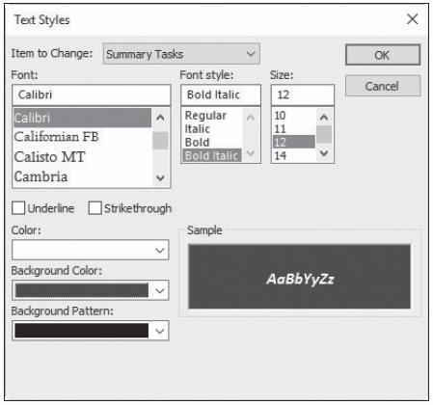
Step-by-Step: Modify the Appearance of Text in a View
In the Size: box, select 12.
In the Color: box, select White.
In the Background Color: box, select dark blue (ScreenTip will show as Blue, Darker 50%). Your Text Styles dialog box will look similar to the figure at right.
Notes:
Text Styles dialog box with summary task formatting changes

Slide 25
Step-by-Step: Modify the Appearance of Text in a View
Click OK. Microsoft Project changes the formatting of all summary tasks to the attributes you specified. Your screen should look similar to the figure on the next slide.
SAVE the project schedule.
PAUSE. LEAVE the project schedule open to use in the next exercise.
Notes:
Take Note: Notice that the Project summary task was not reformatted. This is because the Project Summary task is a separate category and must be reformatted by itself.

Slide 26
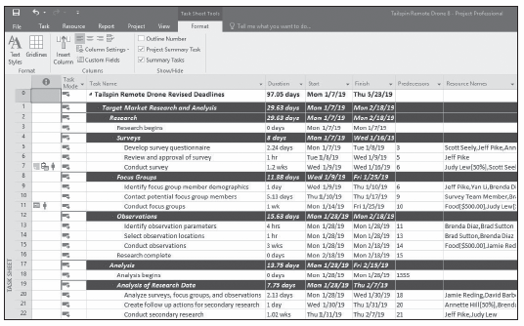
Step-by-Step: Modify the Appearance of Text in a View
Notes:
Task Sheet view with summary tasks reformatted

Slide 27
Modifying the Appearance of a Single Piece of Text
In the following exercise, you will modify a single piece of text in the Task Sheet view using the cost table.
Modified text remains modified every time it is called up in that view, regardless of the table you are using.
For example, if you were to switch to the summary table after you formatted this text, it appears with the new formatting.

Slide 28
Step-by-Step: Modify the Appearance of a Single Piece of Text
GET READY. USE the project schedule from the previous exercise.
On the ribbon, click the View tab. In the Data group, click the Tables button and then select Cost.
Auto‐fit all the columns to see all the data and then select the Total Cost cell for task 38, Internal Testing.
Select the Task tab and then, in the Font group, click the expand button at the lower‐right corner of that group. The Font dialog box appears.
Change the font color to black and the background color to yellow. Your screen should look similar to the figure on the next slide.
Notes:
Take Note: The tables in Microsoft Project might look like Microsoft Excel, but there are distinct differences. For example, you can auto‐fit all columns in Excel at the same time, but you cannot do this in Microsoft Project.

Slide 29
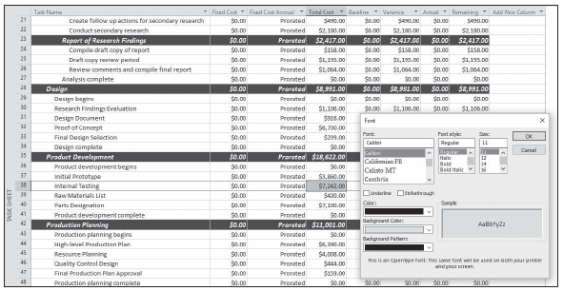
Step-by-Step: Modify the Appearance of a Single Piece of Text
Notes:
Task Sheet view with Font dialog box changes made

Slide 30
Step-by-Step: Modify the Appearance of a Single Piece of Text
Click OK. Notice that only that cell has changed font and background color.
SAVE the project schedule.
PAUSE. LEAVE the project schedule open to use in the next exercise.

Slide 31
Creating Custom Fields
With Microsoft Project, you have the ability to create custom, user‐defined fields to meet your needs. Custom fields are the starting point for you to create customized tables, views, and reports.
In the following exercise, you will create two custom text fields. A custom field is a user-definable field. Text fields are available for you to enter any type of text‐based information. In this exercise, you will create a custom field for the survey location and another for the name of the authority who will approve those locations.
When planning your project, ensure there is justification to set up custom fields. In other words, collecting and recording data simply because the option is available does not mean it is necessarily a good idea. The data you collect and record should add value.

Slide 32
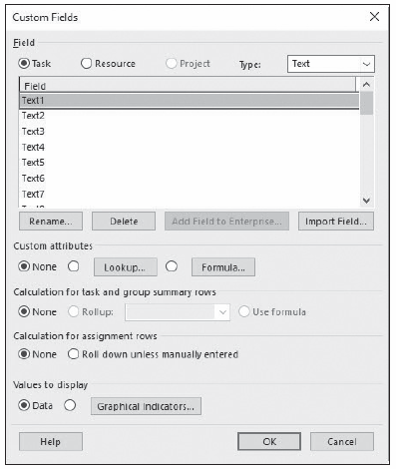
Step-by-Step: Create a Custom Text Field
GET READY. USE the project schedule from the previous exercise.
Click the Format tab. Then, click Custom Fields. The Custom Fields dialog box appears, as shown in the figure at right.
Notes:
Custom Fields dialog box

Slide 33
Step-by-Step: Create a Custom Text Field
Click once on the Text1 field and then click the Rename button.
In the Rename Field dialog box, key Location and then click OK. This field will hold information about the location of where surveys, focus groups, and observations will be conducted.
Click once on the Text2 field and then click the Rename button.
In the Rename Field dialog box, key Approving Authority and then click OK. This field will hold the name of the approving authority at the location where surveys, focus groups, and observations will be conducted.
Click OK to close the Custom Fields dialog box.
SAVE and close the project schedule.
PAUSE. LEAVE Microsoft Project open to use in the next exercise.

Slide 34
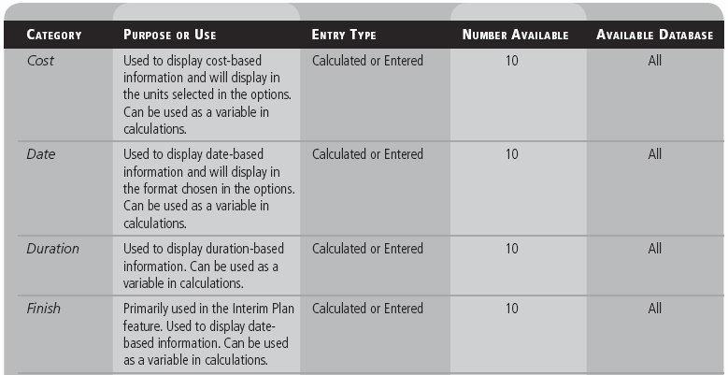
Creating Custom Fields
The table below (which continues on the next slide) displays all nine categories of custom fields, their primary use, the type of entry, the number of fields available, and in which database these fields can be used.
Notes:
In the Microsoft Project task database, there are 130 user‐definable fields available for you to use, broken down into nine categories. Some fields lend themselves to be used in calculations, whereas others are for simply storing text‐based information.

Slide 35
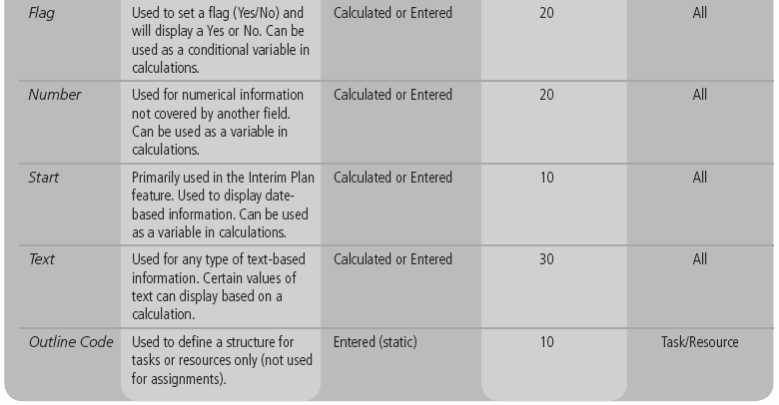
Creating Custom Fields

Slide 36
Creating and Editing Tables
Within Microsoft Project are a number of different tables that can be used in various views. These tables contain most of the commonly used data fields. However, you can create new tables that contain exactly the data you want, such as custom fields, or you can modify any predefined table to meet your needs.
In the following exercise, you will create a custom table to display the information typically found on a video shooting schedule. You will then modify an existing table to include additional data that was important to your project schedule.
As you create future project schedules, keep in mind that you have three options when setting up tables: You can create a new table, redefine an existing table, or copy an existing table and modify it as needed. Also note that as you modify any table, you are changing the definition of that table.

Slide 37
Step-by-Step: Create a Custom Table
GET READY. OPEN the Tailspin Remote Drone 8MA project schedule from the data files for this lesson. SAVE the file as Tailspin Remote Drone 8A in the solutions folder.
Click the View tab, click Tables, and then click More Tables. The More Tables dialog box appears and displays all of the predefined tables available to you, depending on the type of view currently displayed (task or resource).
Confirm that the Task button is selected as the Tables option. Select Entry and then click the Copy button. The Table Definition dialog box appears.
In the Name box, key External Research Schedule Table. Check the Show in menu check box located to the right of the Name box. Now, you will customize the table.

Slide 38
Step-by-Step: Create a Custom Table
In the Field Name column, select the following field names and then click Delete Row after selecting each field name:
Indicators
Task Mode
Duration
Finish
Predecessors
Resource Names
After you have deleted these fields, your screen should look similar to the figure on the next slide.
In the Field Name column, click the down arrow in the next empty cell below Start, and then key or select Location (Text1).

Slide 39
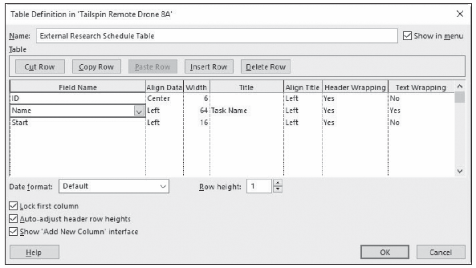
Step-by-Step: Create a Custom Table
In the Align Data column in the same row, select Left. In the Width column, key or select 40.
In the Field Name column in the next empty row below Location, select Approving Authority (Text 2) from the drop‐down list.
Notes:
Table Definition dialog box

Slide 40
Step-by-Step: Create a Custom Table
In the Align Data column in the same row, select Left. In the Width column, key or select 30.
In the Field Name column, select Start, and then click the Cut Row button.
In the Field Name column, select Name, and then click the Paste Row button.
In the Align Data column in the Start row, select Left. In the Width column, key or select 30.
In the Align Data column in the Name row, select Left. In the Width column, key or select 60.
In the Date Format box, select Wed 1/28/09 12:33 pm. Your screen should look similar to the figure on the next slide.

Slide 41
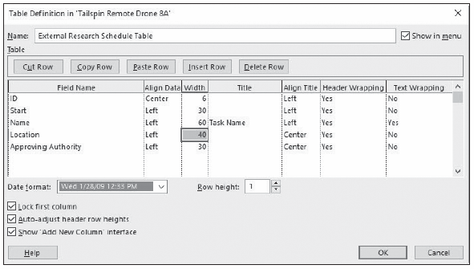
Step-by-Step: Create a Custom Table
Notes:
Table Definition dialog box with changes

Slide 42
Step-by-Step: Create a Custom Table
Click OK to close the Table Definition dialog box. The new table is highlighted in the More Tables dialog box.
Click Apply. Microsoft Project applies the new table to the Task Sheet view. Your screen should look similar to the figure on the next slide.
SAVE the project schedule.
PAUSE. LEAVE the project schedule open to use in the next exercise.

Slide 43
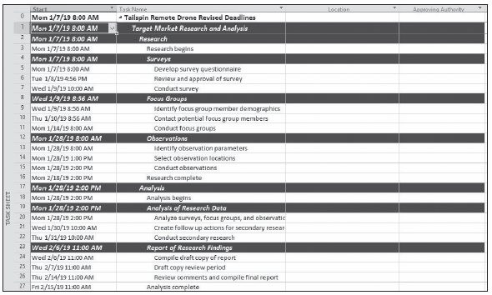
Step-by-Step: Create a Custom Table
Notes:
Task Sheet with the External Research Schedule Table applied

Slide 44
Creating Custom Fields
Microsoft Project includes numerous predefined views. You can use these views, edit an existing view, or create your own view.
In this exercise, you create a custom view using the custom filter and custom table you created in earlier lessons. This custom view will enable you to look at information that is of interest to you.
Recall that a view is a window through which you can see the various elements of a project schedule in a way that is helpful to the viewing audience.
As you will learn in this exercise, a view might contain elements such as tables, groups, or filters. You can combine these with other elements to create almost limitless custom views to suit any purpose.

Slide 45
Step-by-Step: Create a Custom View
GET READY. USE the project schedule you created in the previous exercise.
On the View ribbon, click the down arrow under the Gantt Chart button in the Task Views group, and then click More Views. The More Views dialog box appears, displaying all of the predefined views available to you.
Click the New button. The Define New View dialog box appears. Most views use only a single pane, but a view can consist of two separate panes.
Make sure Single View is selected and then click OK. The View Definition dialog box appears.
In the Name box, key External Research Schedule View.

Slide 46
Step-by-Step: Create a Custom View
In the Screen box, select Task Sheet from the drop‐down list.
In the Table box, select External Research Schedule Table from the drop‐down list. The specific groups in the drop‐down list depend on the type of view you selected in step 5 (task or resource).
In the Group box, select No Group from the drop‐down list. The specific groups in the drop‐down list again depend on the type of view you selected in step 5.
In the Filter box, select Unfinished External Research Tasks from the drop‐down list. The specific groups in the drop‐down list depend on the type of view you selected in step 5. The View Definition dialog box shows all the elements that can make up a view. Your screen should look similar to the figure on the next slide.

Slide 47
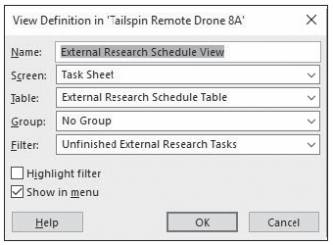
Step-by-Step: Create a Custom View
Notes:
View Definition dialog box

Slide 48
Step-by-Step: Create a Custom View
Select the Show in menu check box and then click OK to close the View Definition dialog box. The new view appears and should be selected in the More Views dialog box.
Click Apply. Microsoft Project applies the new view. Your screen should look similar to the figure on the next slide.
SAVE the project schedule. CLOSE the project schedule.
PAUSE. If you are continuing to the next lesson, keep Microsoft Project open. If you are not continuing to additional lessons, CLOSE Microsoft Project.
Notes:
Take Note: When you select the Show in menu check box, Microsoft Project adds the new view to the View bar. This custom view will be saved with this Microsoft Project data file. You have the option to save all custom items in the Global.MPT (the global template) file, so they are available each time you use Project. To save all new custom items in the Global.MPT file, select File > Options > Advanced. The setting is in the Display section. Activate the check box next to “Automatically add new views, tables, filters, and groups to the global.”

Slide 49
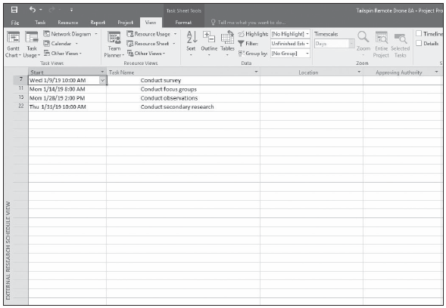
Step-by-Step: Create a Custom View
Notes:
External Research Schedule View custom view with custom table and Unfinished External Research Tasks filter applied

Slide 50
Skill Summary

